Slide 1
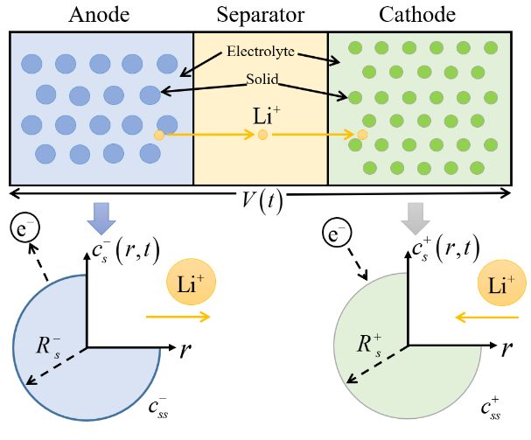
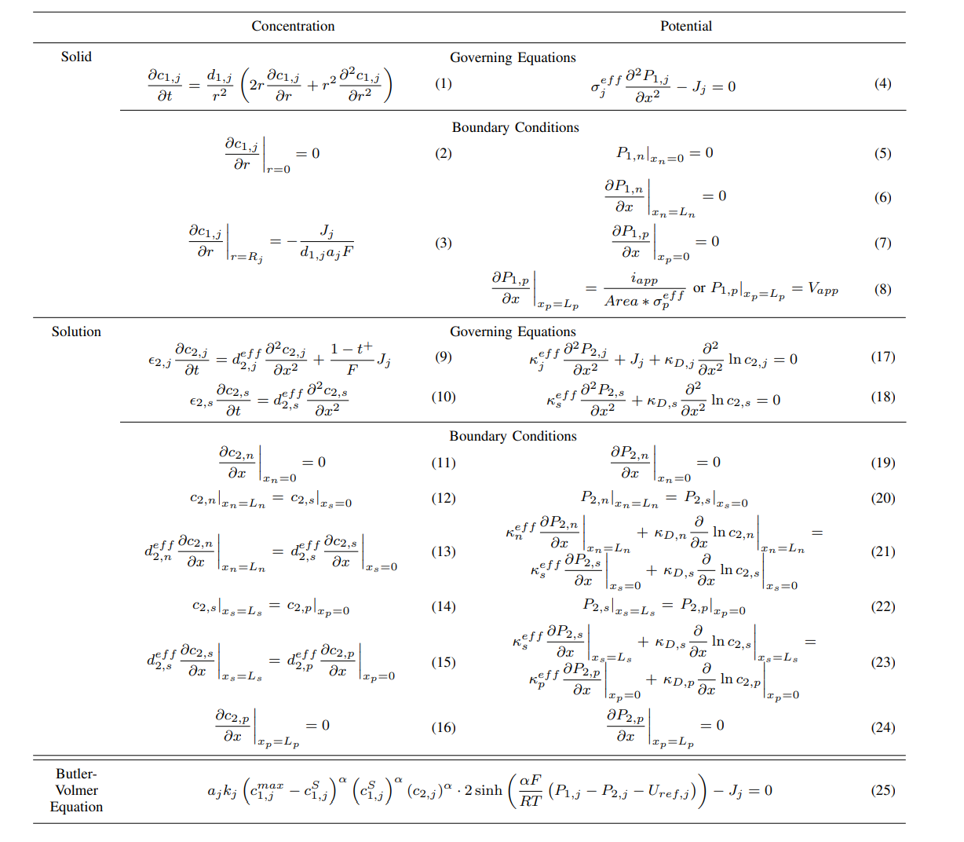
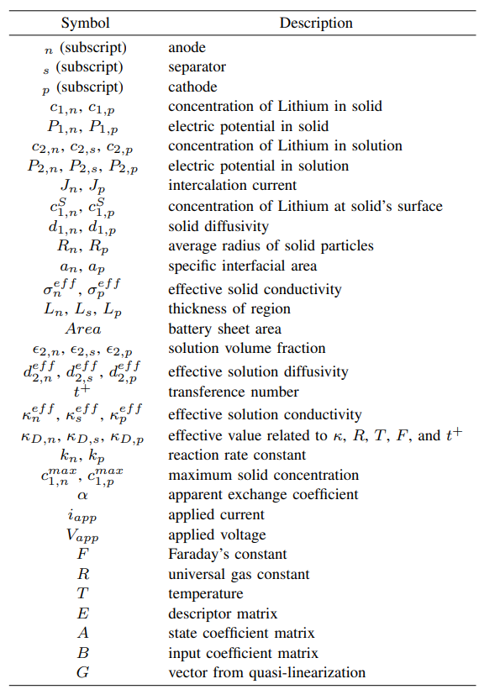
Model Description
Lithium-ion batteries are made of stacked layers of thin sheets of material: a negative current collector, an anode, a separator, a cathode, and a positive current collector.
Sketch of the DFN concept
Notes:
Theoretical advantages:
High computational efficiency
The algorithm complexity is O (n), requiring only one traversal and simple numerical operations
No need to retrain the model, it can be directly applied to the prediction stage
Compared to sampling methods such as SMOTE, it does not increase training overhead
Good mathematical properties
Maintaining the basic constraint of probability sum of 1
Adaptive adjustment of probability distribution is achieved through threshold mechanism
The design of the amplification factor ensures the rationality of the proportion of probability redistribution

Slide 2
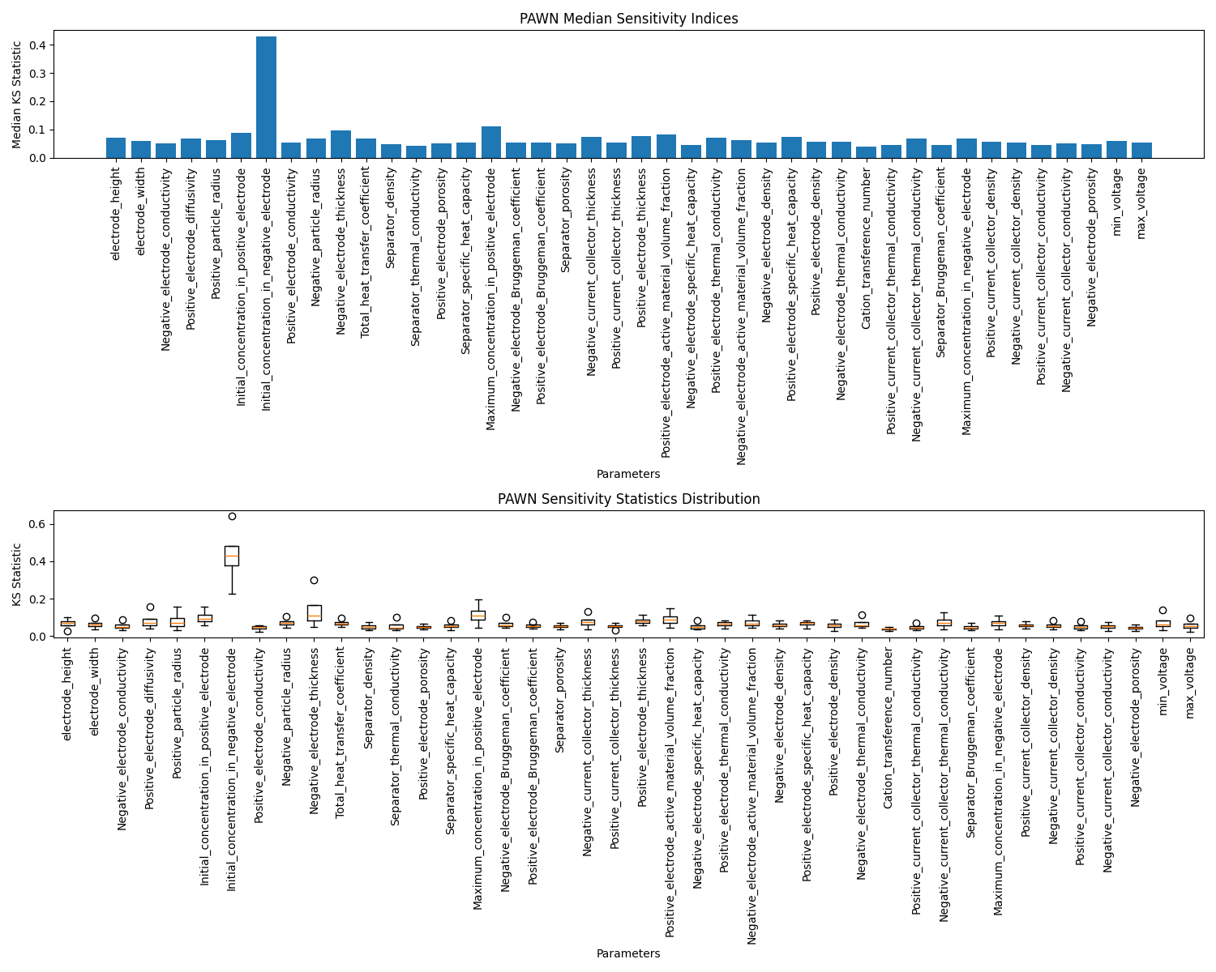
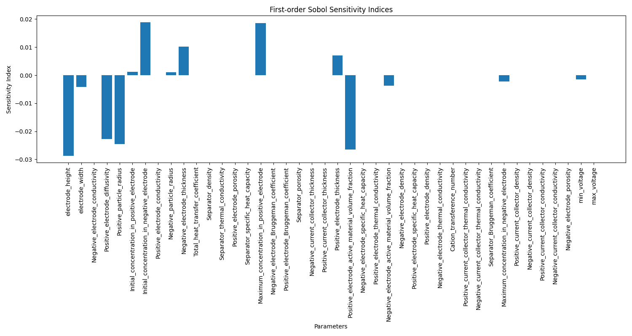
Global Sensitivity based Parameter Selection
PAWN
Sobol
How to design an appropriate sensitivity measure?
Voltage Mean + Voltage Stability + Voltage Flatness
Notes:
Theoretical advantages:
High computational efficiency
The algorithm complexity is O (n), requiring only one traversal and simple numerical operations
No need to retrain the model, it can be directly applied to the prediction stage
Compared to sampling methods such as SMOTE, it does not increase training overhead
Good mathematical properties
Maintaining the basic constraint of probability sum of 1
Adaptive adjustment of probability distribution is achieved through threshold mechanism
The design of the amplification factor ensures the rationality of the proportion of probability redistribution

Slide 3
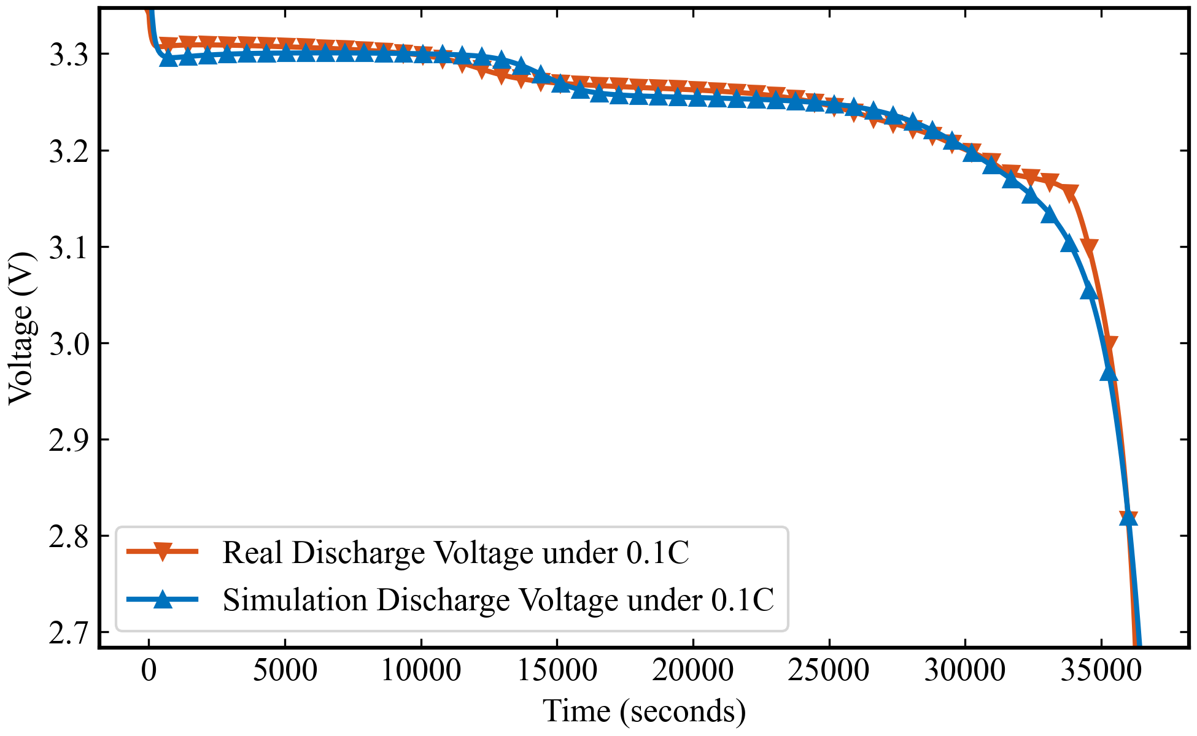
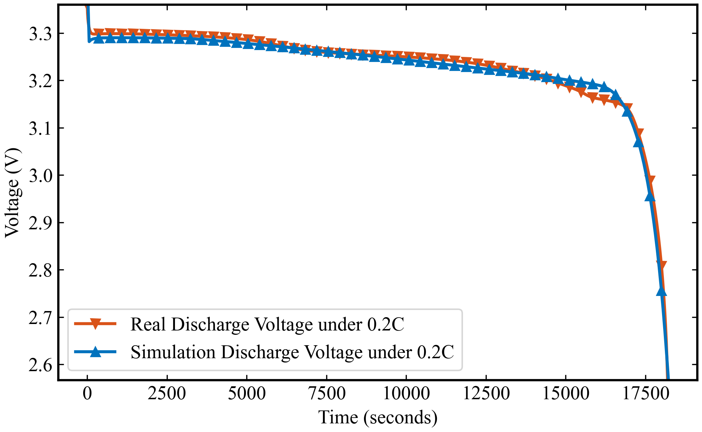
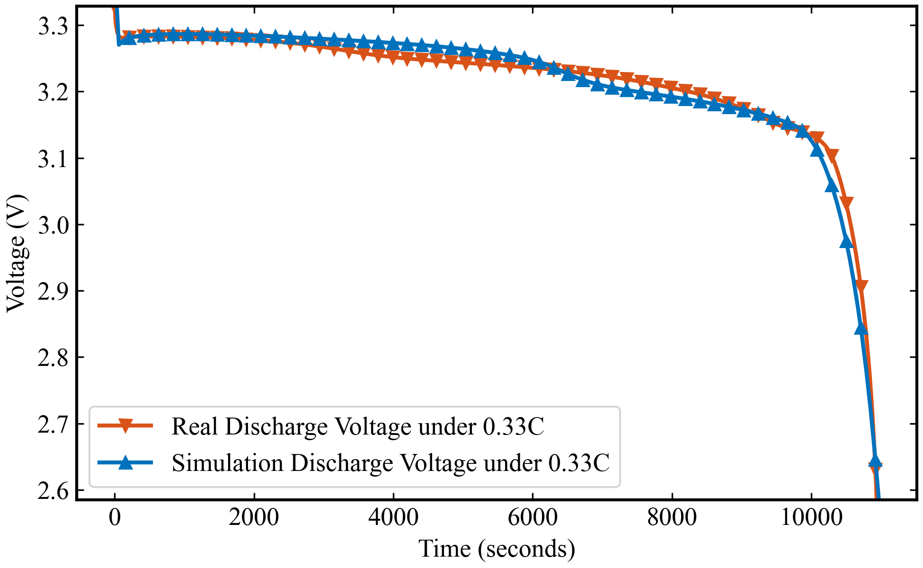
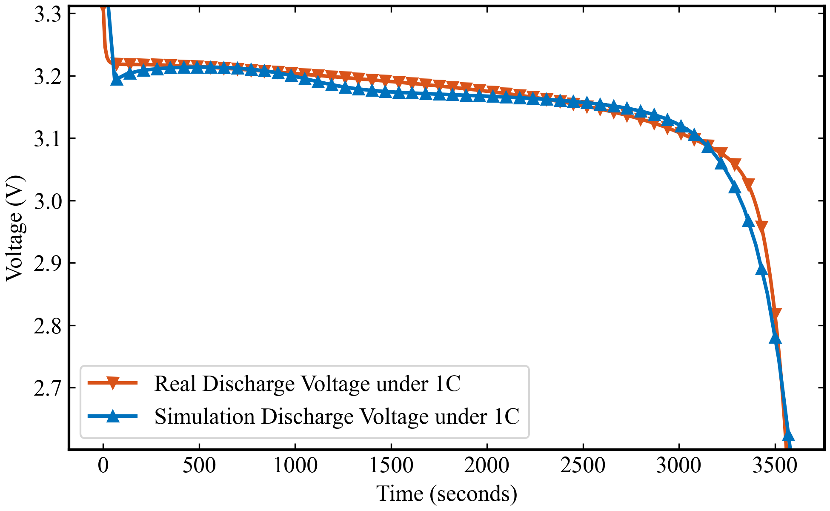
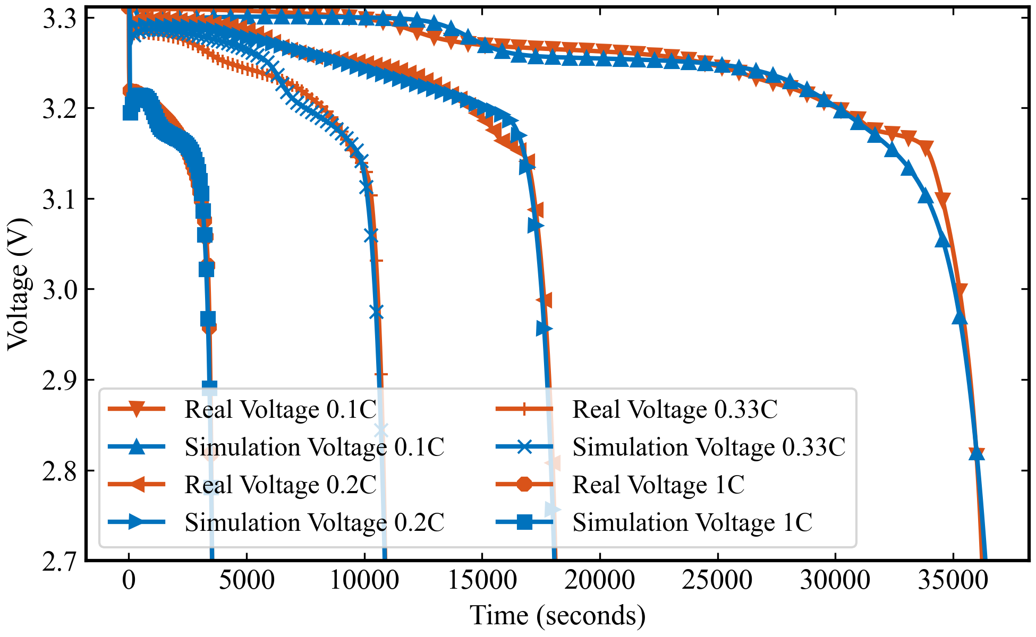
单工况参数辨识实验结果
RMSE for 0.1C: 7.4 mV
RMSE for 0.2C: 6.0 mV
RMSE for 0.33C: 12.5 mV
RMSE for 1C: 10.3 mV
算法：NSGA 电池模型：DFN
参数量：42 不同工况独立训练，得出的参数不同
DFN模型是一个基于物理的电池模型，它源自于Doyle等人的工作，并由Fuller和Newman进一步发展。这个模型详细描述了锂离子电池的电化学行为，包括锂离子在电极中的扩散、电解液中锂离子的迁移和电池的电荷平衡。
DFN模型能够模拟电池的电压响应，预测电池性能，并且是理解和预测电池退化现象的重要工具。
Notes:
Theoretical advantages:
High computational efficiency
The algorithm complexity is O (n), requiring only one traversal and simple numerical operations
No need to retrain the model, it can be directly applied to the prediction stage
Compared to sampling methods such as SMOTE, it does not increase training overhead
Good mathematical properties
Maintaining the basic constraint of probability sum of 1
Adaptive adjustment of probability distribution is achieved through threshold mechanism
The design of the amplification factor ensures the rationality of the proportion of probability redistribution

Slide 4
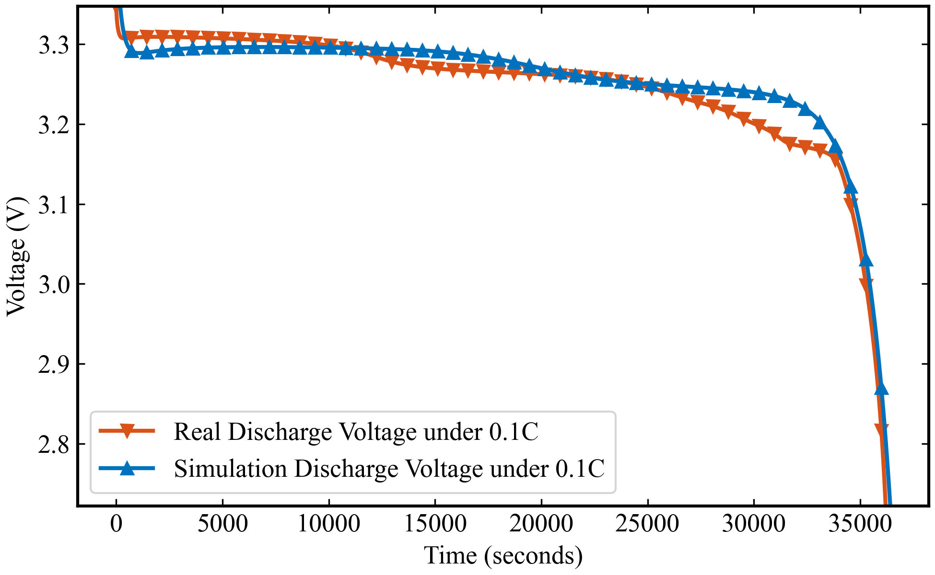
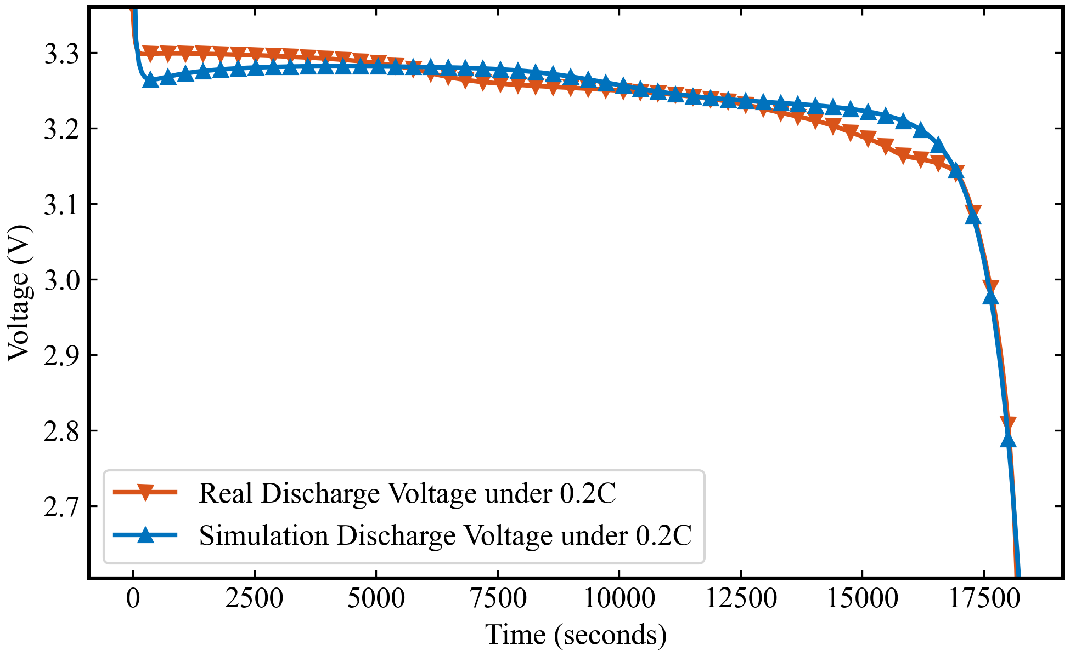
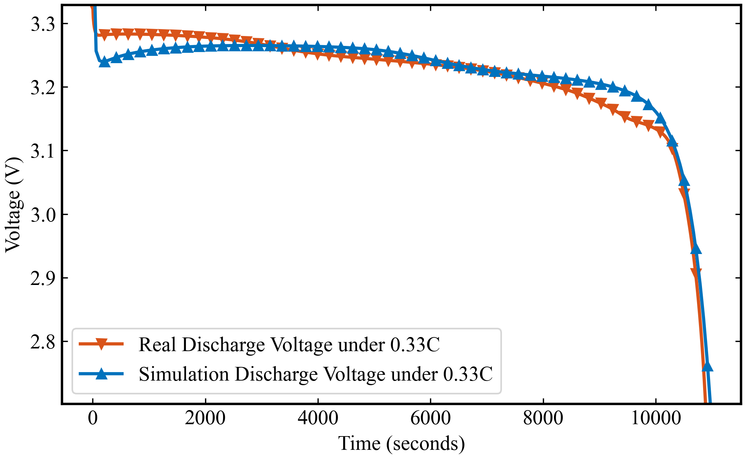
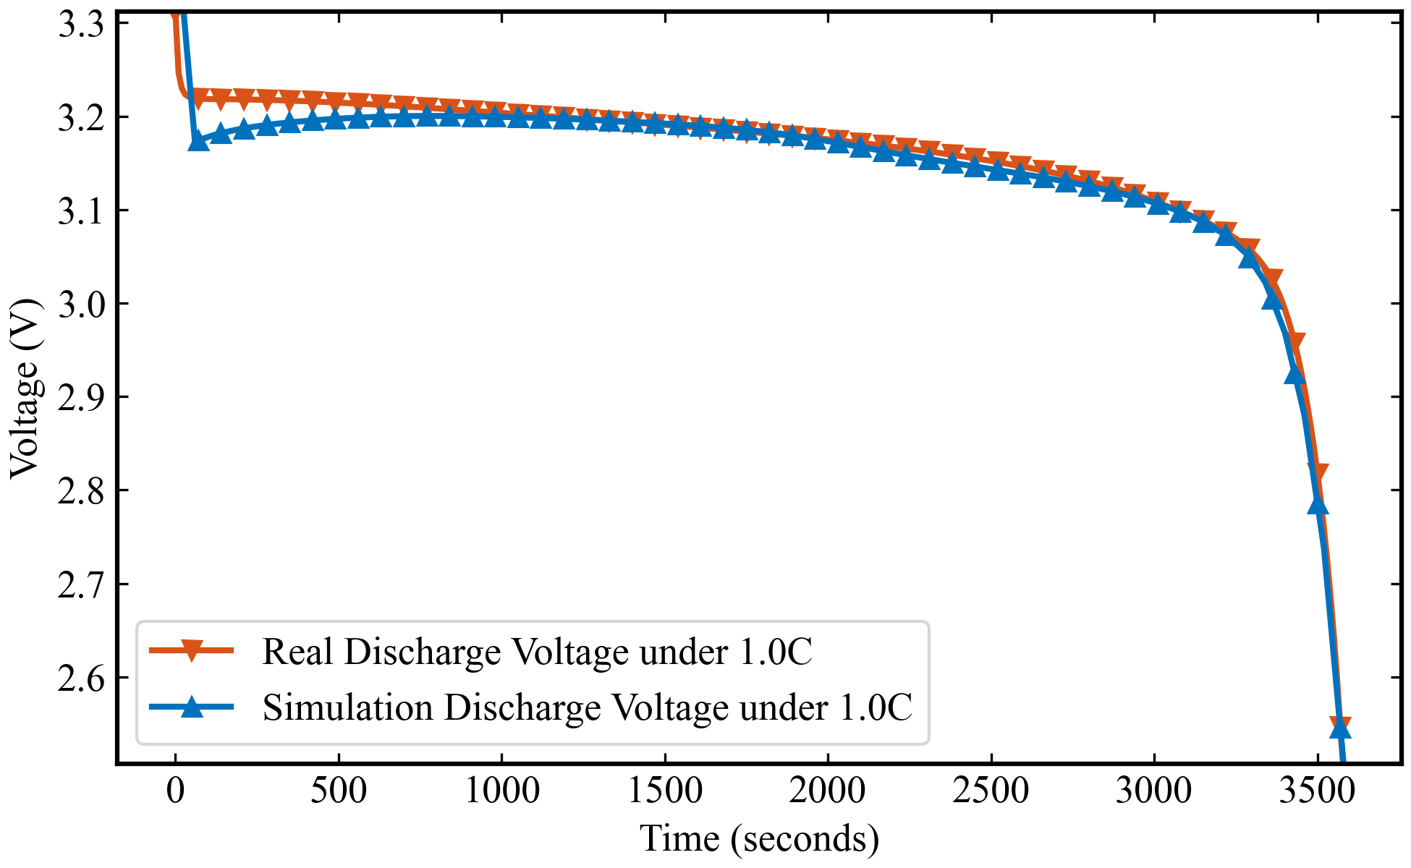
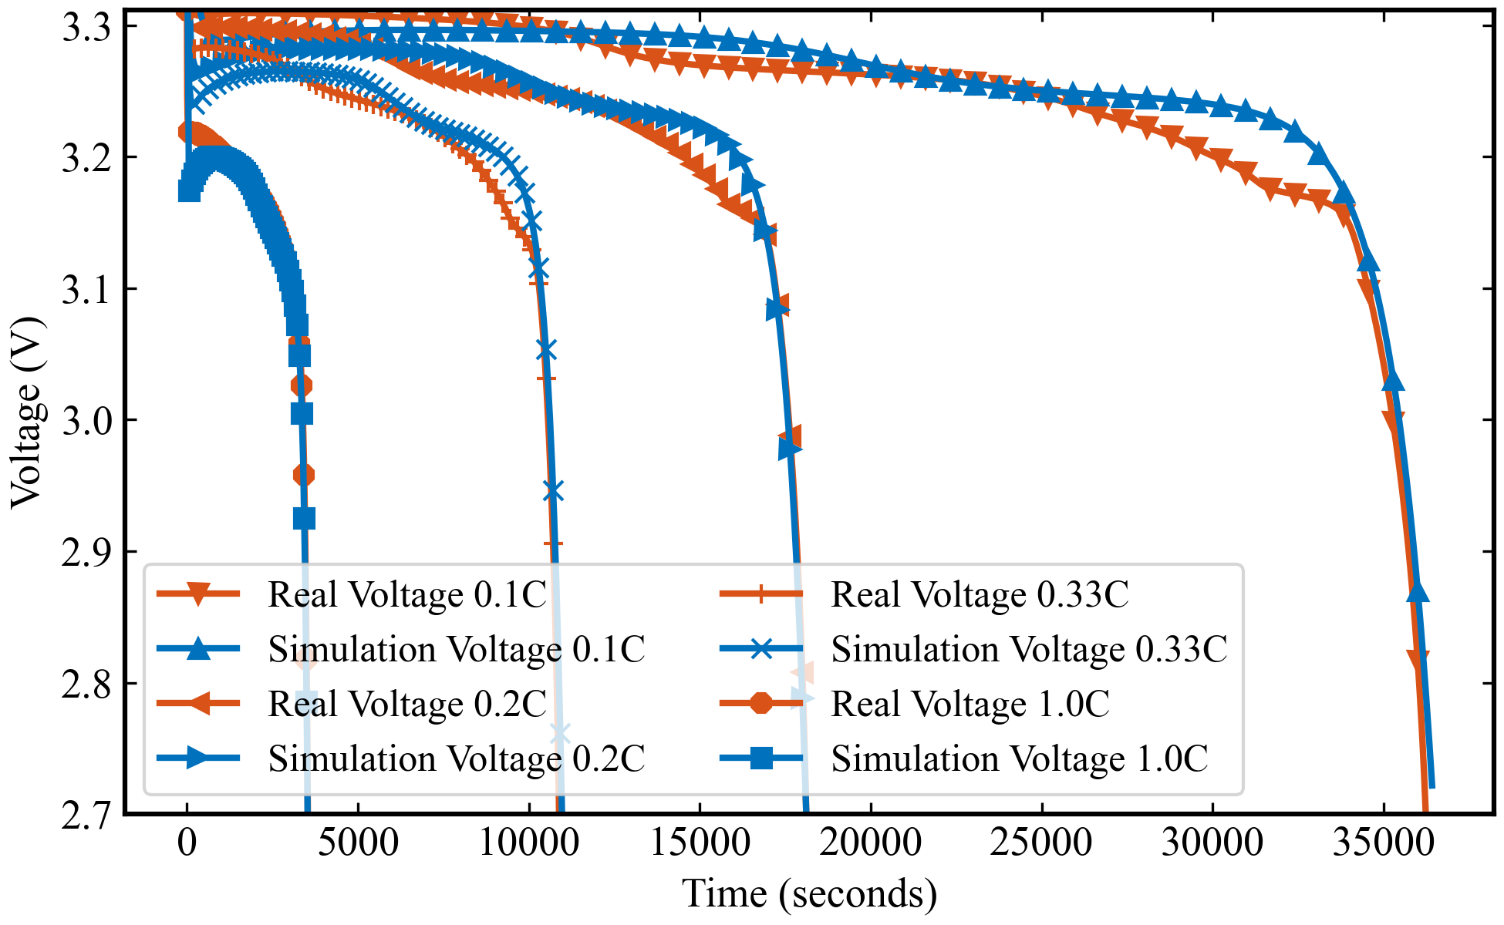
跨工况参数辨识实验结果
RMSE for 0.1C: 13.5 mV
RMSE for 0.2C: 12.2 mV
RMSE for 0.33C: 10.7 mV
RMSE for 1C: 5.3 mV
算法：NSGA 电池模型：DFN
参数量：42 跨工况联合训练，相同电化学参数，在后续的实验中，我们会加入DFN模型与SPMe模型的结果对比
DFN与SPMe模型的区别
模型维度和复杂性：DFN模型更为复杂，考虑了电极的多孔结构和详细的电化学机制，而SPMe模型则简化了这些过程，将电极视为单个球形粒子。
计算成本：DFN模型由于其复杂性，计算成本较高，而SPMe模型通过简化模型结构，显著降低了计算成本。
Notes:
Theoretical advantages:
High computational efficiency
The algorithm complexity is O (n), requiring only one traversal and simple numerical operations
No need to retrain the model, it can be directly applied to the prediction stage
Compared to sampling methods such as SMOTE, it does not increase training overhead
Good mathematical properties
Maintaining the basic constraint of probability sum of 1
Adaptive adjustment of probability distribution is achieved through threshold mechanism
The design of the amplification factor ensures the rationality of the proportion of probability redistribution

Slide 5
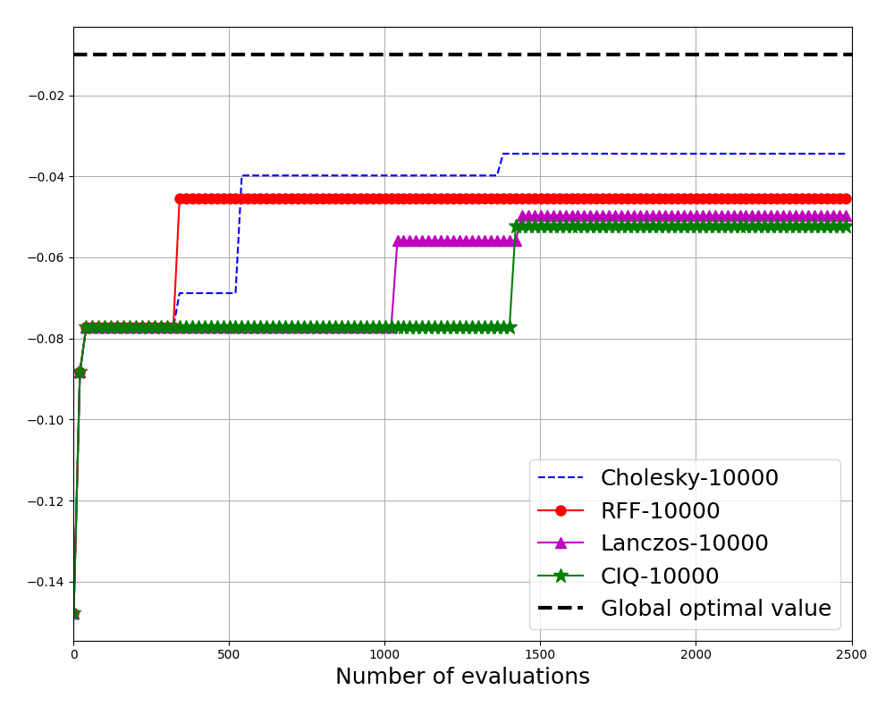
Large-scale Thompson sampling
Four approaches are currently considered to discrete Thompson sampling on m candidates points:
Exact sampling with Cholesky: Computing a Cholesky decomposition of the corresponding m x m covariance matrix which reuquires O(m^3) computational cost and O(m^2) space. This is the standard approach to sampling from a Gaussian process, but the quadratic memory usage and cubic compliexity limits the number of candidate points.
Contour integral quadrature (CIQ): CIQ is a Krylov subspace method combined with a rational approximation that can be used for computing matrix square roots of covariance matrices, which is the main bottleneck when sampling from a Gaussian process. CIQ relies on computing matrix vector multiplications with the exact kernel matrix which requires O(m^2) computational complexity and space.
Lanczos: Rather than using CIQ, we can solve the linear systems K^(1/2) v = b using Lanczos and the conjugate gradient (CG) method. This will be faster than CIQ, but will generally produce samples of worse quality. Random Fourier features (RFFs): The RFF kernel: we use it as implemented in GPyTorch. RFFs are computationally cheap to work with as the computational cost and space are both O(km) where k is the number of Fourier features.
Notes:
Theoretical advantages:
High computational efficiency
The algorithm complexity is O (n), requiring only one traversal and simple numerical operations
No need to retrain the model, it can be directly applied to the prediction stage
Compared to sampling methods such as SMOTE, it does not increase training overhead
Good mathematical properties
Maintaining the basic constraint of probability sum of 1
Adaptive adjustment of probability distribution is achieved through threshold mechanism
The design of the amplification factor ensures the rationality of the proportion of probability redistribution

Slide 6
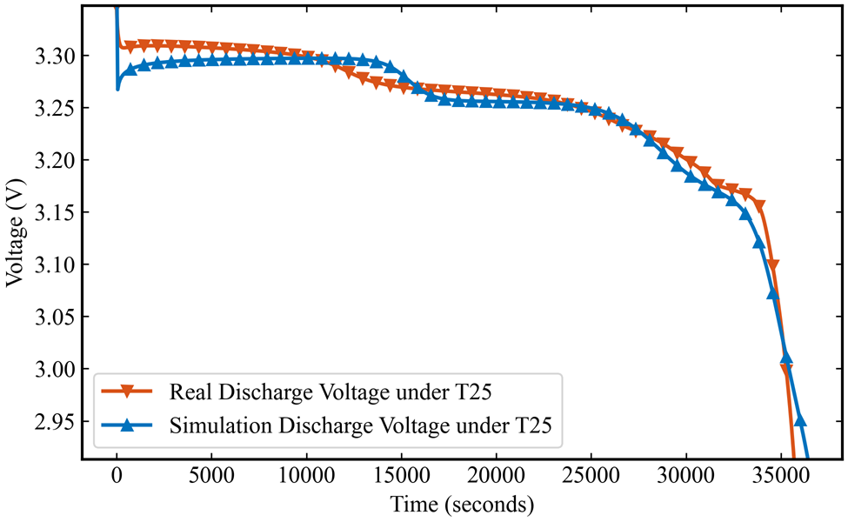
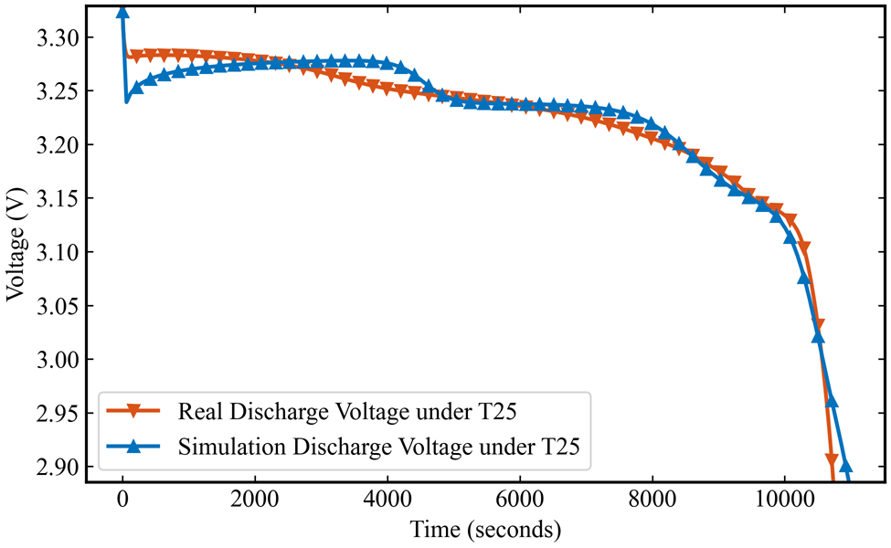
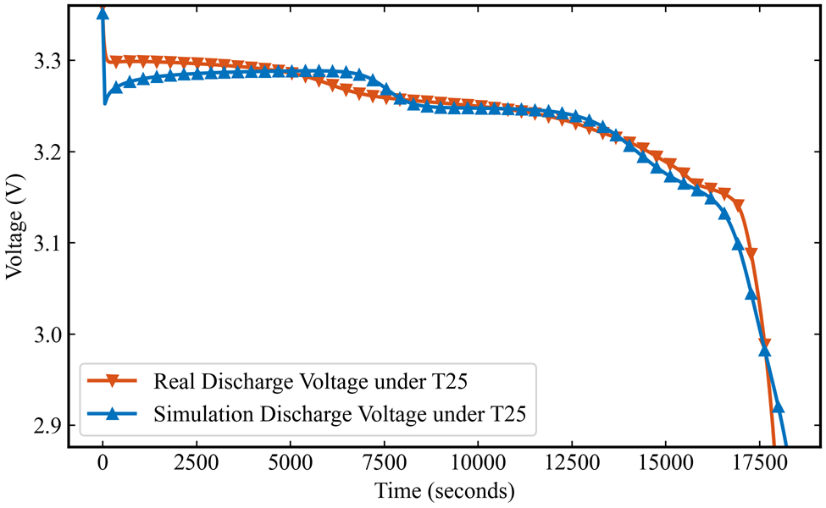
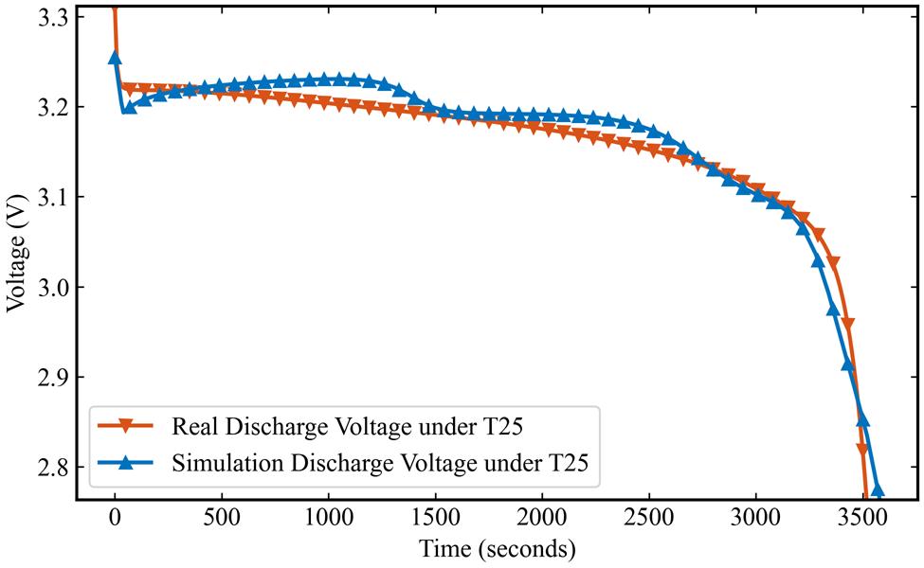
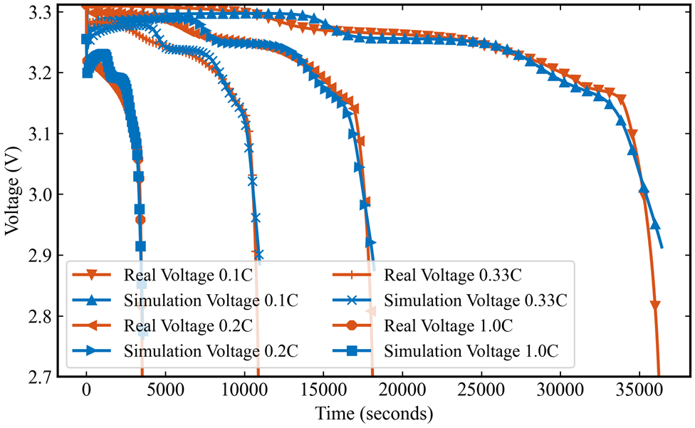
跨工况参数辨识实验结果
RMSE for 0.1C: 8.2 mV
RMSE for 0.2C: 8.4 mV
RMSE for 0.33C: 11.6 mV
RMSE for 1C: 19.3 mV
算法：BO 电池模型：DFN
参数量：26
Notes:
Theoretical advantages:
High computational efficiency
The algorithm complexity is O (n), requiring only one traversal and simple numerical operations
No need to retrain the model, it can be directly applied to the prediction stage
Compared to sampling methods such as SMOTE, it does not increase training overhead
Good mathematical properties
Maintaining the basic constraint of probability sum of 1
Adaptive adjustment of probability distribution is achieved through threshold mechanism
The design of the amplification factor ensures the rationality of the proportion of probability redistribution

